Slide 1
Mobile Testing

Slide 2
Agenda
What are the challenges in mobile testing
Types of mobile applications
Common issues with mobile apps
Emulators and Simulators vs. Real Devices
Test automation approaches and tools
Getting started with Appium

Slide 3
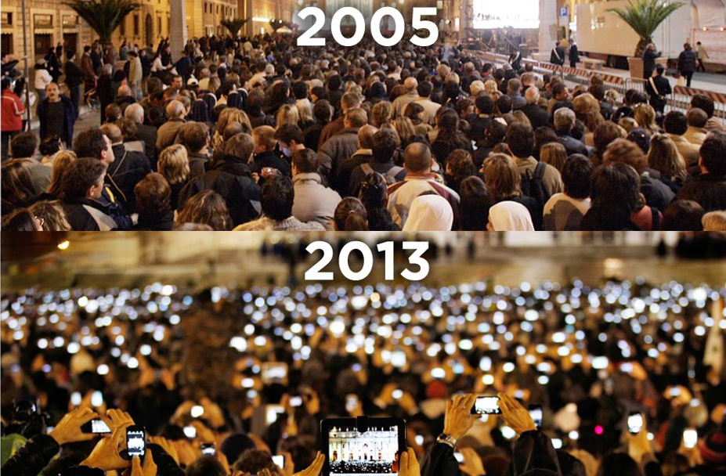
Notes:
Д:
Това е снимка от площада Св. Петър през 2005-та и 2013-та година. Сами виждате разликата - днес всеки има телефон, на всички тези телефони имаме редица мобилни приложения. Днес ще говорим имено за тях и как да осигурим тяхното качество.

Slide 4
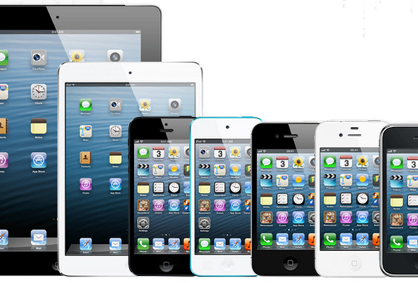
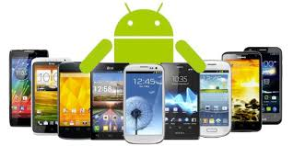
Challenges of mobile testing
40+ iOS devices​
18K+ Android devices​
Different hardware and screen sizes​
Different network types (2G, 3G, 4G or WIFI)

Slide 5
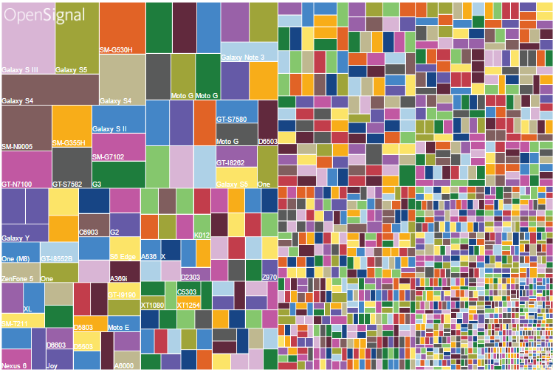

Slide 6
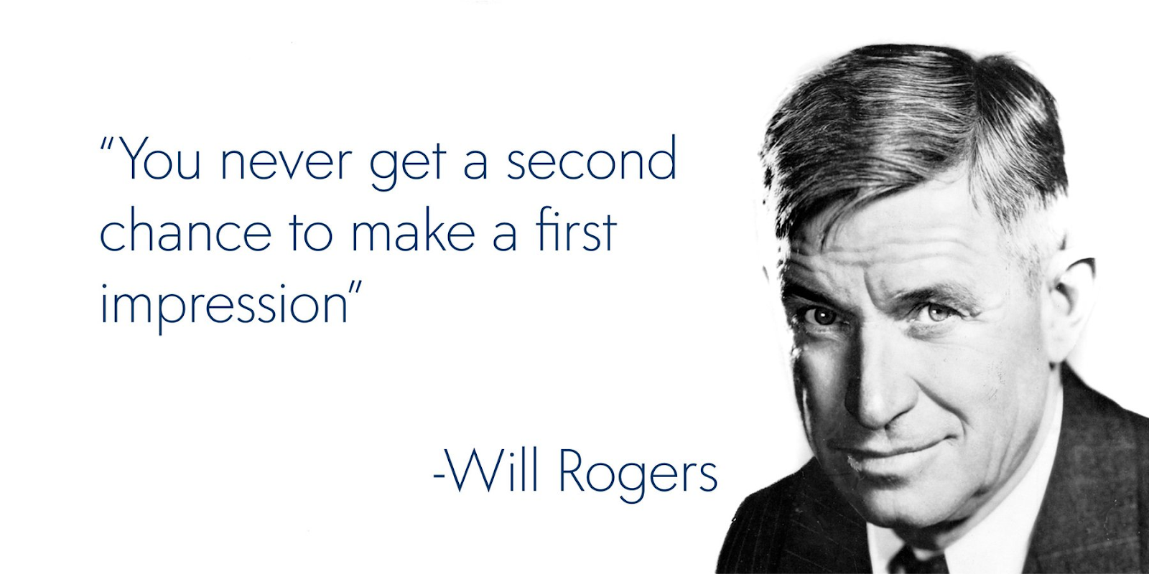

Slide 7
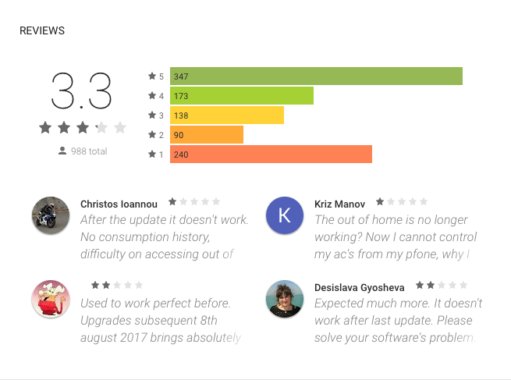

Slide 8
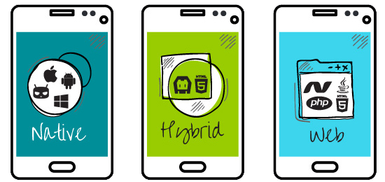
Types of mobile applications
Can take full advantage of all the device features – camera, GPS, accelerometer, compass
Available at application store (Google Play or App Store)​
Developed as separate app for each platform
Java or Kotlin for Android
Objective C or Swift for iOS
Or developed using frameworks for cross platform native mobile development like Xamarin, ReactNative, Flutter or NativeScript​.

Slide 9
Types of mobile applications
Part native part web​ app.
Live in an app store and can take advantage of the many device features​.
Rely on HTML being rendered in a browser embedded within the app​.
Allow cross-platform development and thus significantly reduce development costs​.
Drawbacks:
Not fluent native experience
Less performant

Slide 10
Types of mobile applications
Web optimized for mobile form factor
Cannot be distributed through native app stores like the App Store or Google Play​
The cheapest option

Slide 11
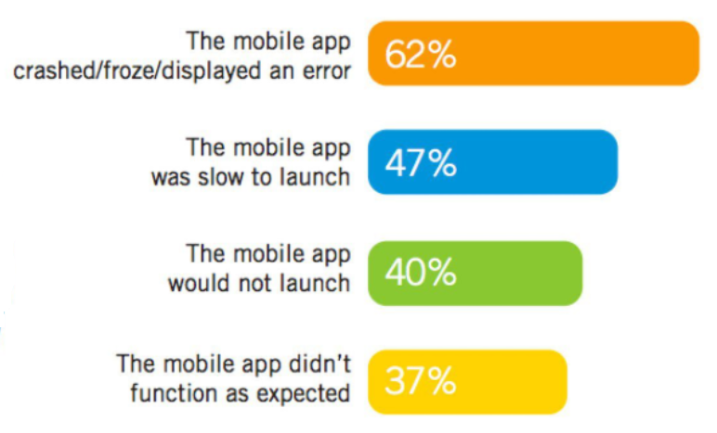
Common issues with mobile apps

Slide 12
Crashes
Wrong CPU architecture
Using APIs not available at current OS versions
Memory leaks
Rotate app
Run in background
Interruptions (calls, sms, notifications)

Slide 13
Freezes
Run heavy operations on the main thread

Slide 14
Slow Launch
One of the top reasons to uninstall an app
Do not underestimate it!

Slide 15
Issues with Functionality
No recipe here

Slide 16
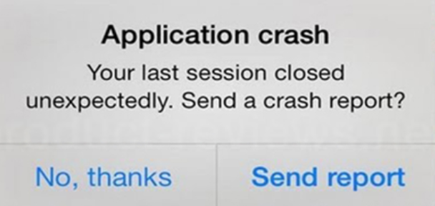
Crash Analytics

Slide 17

Emulators
Real Devices

Slide 18
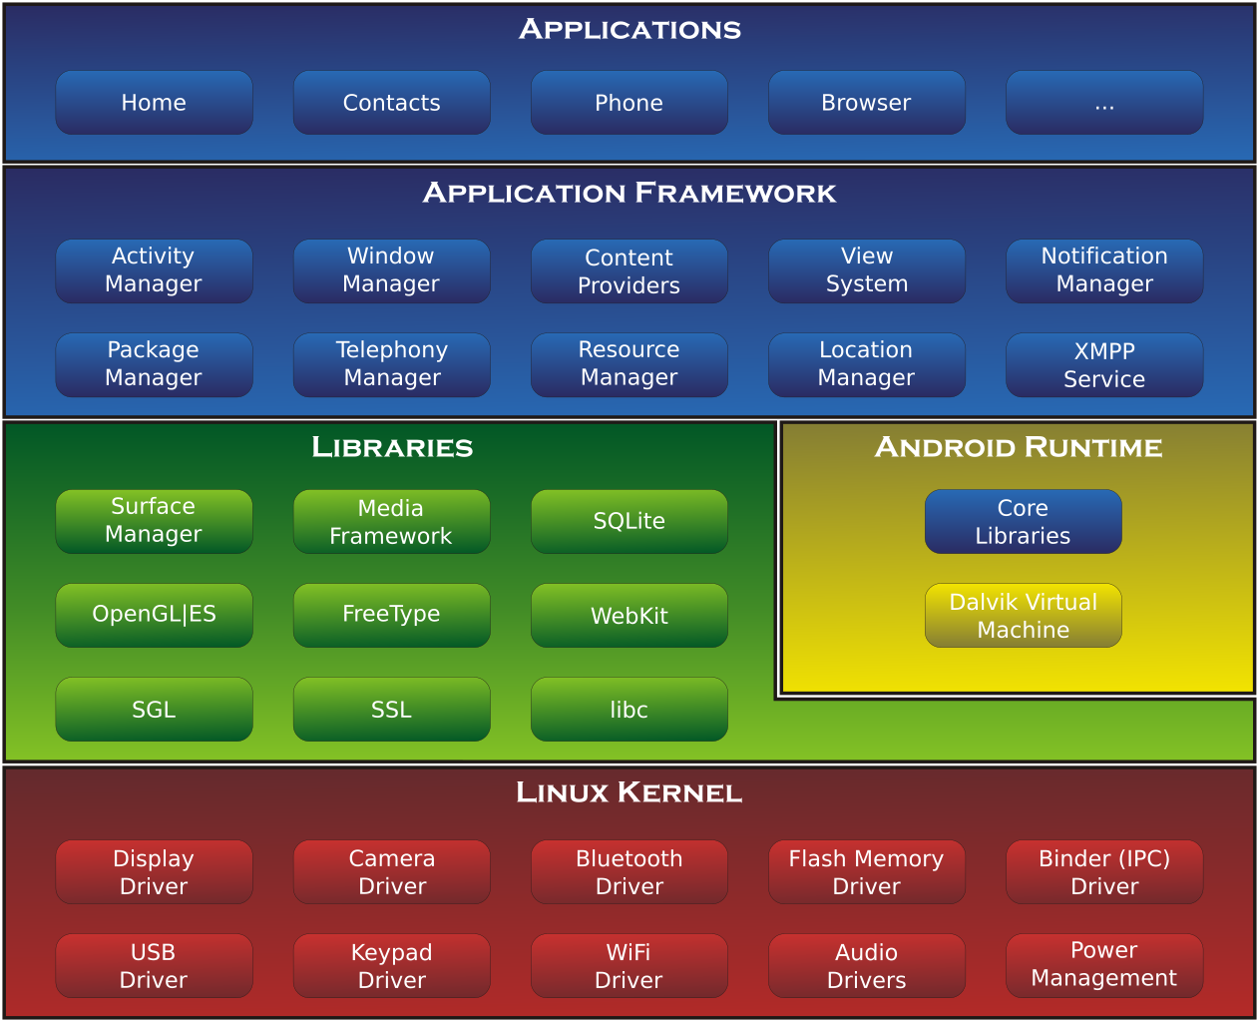

Slide 19


Emulators
Advantages
Cheap
Fast
Scale
Can capture almost all issues related to business logic, OS version, screen size and memory constraints
Disadvantages
Not good option to test performance
Not good option to test sensor and camera related things
Can not capture vendor specific issues

Slide 20
Real devices
Advantages
Can capture all issues that emulators can’t
Disadvantages
Expensive
Hard to scale
Flaky

Slide 21
Device clouds
A device cloud is a mobile testing environment that enables developers test on a wide range of smart devices remotely.
Advantages
No purchase and maintenance of devices
Wide range of available devices
Access from anywhere in the world
Reports and logs out of the box
Disadvantages
Expensive
Sometimes late with updates
Device is not with you and can not test all real world scenarios

Slide 22
In groups
Start a simulator/emulator on your machine and deploy the provided app.
Notes:
http://judge.telerikacademy.com/problem/14abovemaindiag

Slide 23

Tools and Approaches

Slide 24
Official Vendor Solutions
Shipped by Google and Apple
The official wat to test Android and iOS
Advantages
Stable
Same days support for new versions
Disadvantages
Platform specific
No code reuse

Slide 25
Based on Instrumentation
Modify app under test (integrate library that allow testing it)
Used in some gray box frameworks like Detox
Used in most of the commercial tools
Advantages
Usually provide more control and speed
Disadvantages
App under test != App that can be released

Slide 26
Based on Images
Locate everything based on image recognition
Available in latest Appium versions
Sikuli
Advantages
Sometimes the only option for testing apps without accessibility (like games)
Technology agnostic
Disadvantages
Hard to scale on large set of devices

Slide 27
Appium
Cross platform solution based on vendor build in tools
Open source
Advantages
Cross platform (allow single code base)
Can write tests in any language
Use WebDriver protocol
Disadvantages
Same day support not guarantied

Slide 28
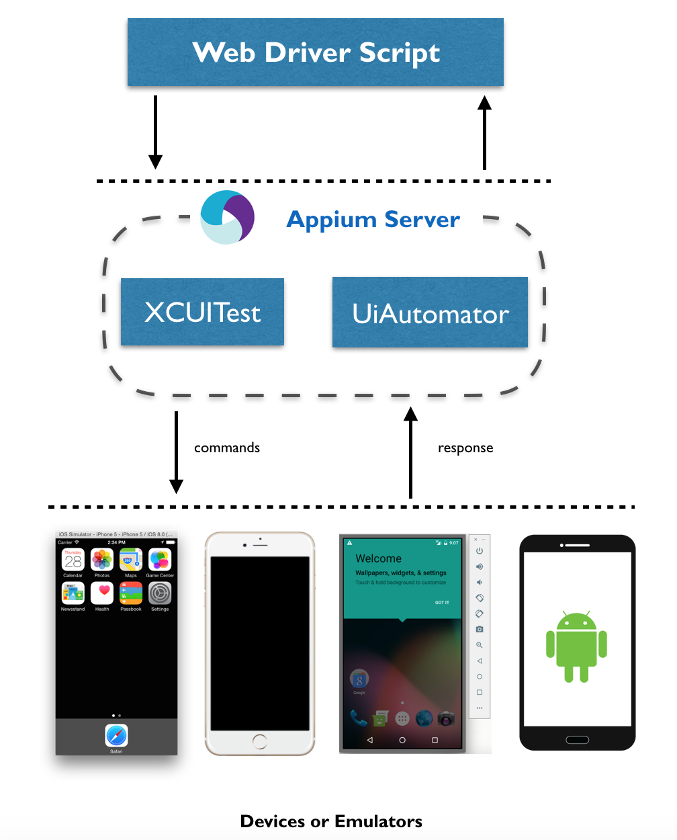
Appium Architecture
Write tests scripts in any language
Script actually send HTTP requests to NodeJS server (Appium server)
Appium server calls native automation APIs that interact with devices/emulators

Slide 29
Inspect UI
Appium Desktop Application
Android UIAutomatorViewer

Slide 30
Questions?

Slide 31
In groups
Create an automated test with Appium.
Notes:
http://judge.telerikacademy.com/problem/14abovemaindiag

